Slide 1
BUDGET CHANGES – FY 2023-24
Impact on Payroll
OLd Tax Regime VS New Tax Regime
Effective April 2023

Slide 2

Table of Contents
Budget changes, financial year 2023-24
Income tax slabs, Old Regime and New Regime
Tax Impact - Salary Components
TAX Impact - Various Investment Sections
Preferred Income tax regime
Income tax simulator & FAQ on New tax regime
HGS Portal – selection of tax regime
Marginal tax relief exceeding Rs.7 lakhs

Slide 3
Budget changes, fY 2023-24 - Impact on Individual
The Finance Minister, Nirmala Sitharaman, unveiled the Union Budget 2023 on 1st February 2023.
The Union Budget 2023-24 introduced some significant amendments to streamline taxation, promote economic growth and rectify gaps to ensure effective and efficient tax governance in the country.
Highlighting some of the tax announcements that Employees should be aware before opting for Old Tax Regime OR New Tax Regime
The new tax regime now becomes the default tax regime. However, taxpayers have an option to choose the Old tax regime. In case, Employee doesn’t opt for any tax regime, then, New Tax Regime will be considered as the default regime for the financial year.
Tax rebate on an income of up to ₹7 lakhs has been introduced under the New Tax Regime.
This means that taxpayers with an income of up to ₹7 lakhs will not have to pay any tax at all!
Standard Deduction of ₹50,000 has been extended under the New Tax Regime.
Effectively, ₹7.5 lakhs is your tax-free income under the new regime.
Marginal tax relief under New Tax Regime for income exceeding Rs.7 lakhs
No Changes in Income tax slabs/tax rates/rebate for Old Tax Regime.

Slide 4
Income tax slabs, Old Regime and New Regime
Old Regime | Tax Rate | Surcharge | Education Cess | Tot Tax Rate |  | New Regime | Tax Rate | Surcharge | Education Cess | Tot. Tax Rate
Taxable Income (₹) |  |  |  | Sur./Cess |  | Taxable Income (₹) |  |  |  | Sur./Cess
Up to 250,000 | - | - | - | - |  | Up to 3,00,000 | - | - | - | -
250,001 - 500,000 | 5% | - | 4% | 5.20% |  | 3,00,001 - 600,000 | 5% | - | 4% | 5.20%
500,001 - 10,00,000 | 20% | - | 4% | 20.80% |  | 600,001 - 9,00,000 | 10% | - | 4% | 10.40%
10,00,001 - 50,00,000 | 30% | - | 4% | 31.20% |  | 9,00,001 - 12,00,000 | 15% | - | 4% | 15.60%
5,000,001 - 1 crore | 30% | 10% | 4% | 34.32% |  | 12,0,001 - 15,00,000 | 20% | - | 4% | 20.80%
1 Crore - 2 Crore | 30% | 15% | 4% | 35.88% |  | 1,500,001 - 5,000,000 | 30% | - | 4% | 31.20%
2 Crore - 5 Crore | 30% | 25% | 4% | 39.00% |  | 5,000,001 - 1 Crore | 30% | 10% | 4% | 34.32%
Above 5 Crore | 30% | 37% | 4% | 42.74% |  | 1 Crore - 2 Crore | 30% | 15% | 4% | 35.88%
 |  |  |  |  |  | Above 2 Crore | 30% | 25% | 4% | 39.00%
Effective Tax-Free Salary income (A) |  |  |  | ₹ 6,00,000 |  | Effective Tax-Free Salary income (A) |  |  |  | ₹ 7,50,000
Less : Standard Deduction (B) |  |  |  | ₹ 50,000 |  | Less : Standard Deduction (B) |  |  |  | ₹ 50,000
Gross Total Income (C = A-B) |  |  |  | ₹ 5,50,000 |  | Gross Total Income (C = A-B) |  |  |  | ₹ 7,00,000
 |  |  |  |  |  | Less : Chapter VI-A deductions (D) |  |  |  | -
Less : Chapter VI-A deductions (D) |  |  |  | ₹ 50,000
Taxable Income level for Rebate eligibility (C-D) |  |  |  | ₹ 5,00,000 |  | Taxable Income level for Rebate eligibility (C-D) |  |  |  | ₹ 7,00,000
Income Tax on above Income (as per slab rates) |  |  |  | ₹ 12,500 |  | Income Tax on above Income (as per slab rates) |  |  |  | ₹ 25,000
Rebate under Section 87A |  |  |  | ₹ (12,500) |  | Rebate under Section 87A |  |  |  | ₹ (25,000)
Net Income tax payable (Upto Taxable Income ₹5 L p.a.) |  |  |  | ₹ 0 |  | Net Income tax payable (Upto Taxable Income ₹7L p.a.) |  |  |  | ₹ 0
Tax Credit of ₹ 12,500 for Taxable Income < ₹5 lakhs per annum |  |  |  |  |  | Tax Credit of ₹ 25,000 for Taxable Income < ₹7 lakhs per annum
Note 1: Where Taxable Income after Chapter VI-A deductions is above INR 5Lakhs (INR 5,00,001), rebate u/s 87A is not applicable i.e. tax to be paid as per slab rates.
Note 2: Rebate of INR 12,500 is not to be considered as a basic exemption limit.
Note 1: Where Taxable Income is above INR 7Lakhs (INR 7,00,001), rebate u/s 87A is not applicable i.e. tax to be paid as per slab rates.
Note 2: Rebate of INR 25,000 is not to be considered as a basic exemption limit.
Note 3: Marginal tax relief under New Regime for income exceeding Rs.7 lakhs

Slide 5
Tax Impact – Salary Components
# | Regular Components | Old Tax Regime | New Tax Regime | Change / No Change Old Vs New
1 | Basic Salary | Taxable | Taxable | No Change
2 | House Rent Allowance | Exempted on Submission of Documents | Taxable | Change
3 | Statutory Bonus (Applicable to specific Grades) | Taxable | Taxable | No Change
# | OAAR-1 Components | Old Tax Regime | New Tax Regime | Old Vs New
4 | Remote Working Allowance | Tax Free Exemption | Tax Free Exemption | No Change
5 | Books and Journals | Tax Free Exemption | Taxable | Change
6 | Professional Pursuit | Tax Free Exemption | Taxable | Change
7 | Conveyance Allowance | Exempted for differently abled Employees as per the rules. | Exempted for differently abled Employees as per the rules. | No Change
# | OAAR - 2 Components | Old Tax Regime | New Tax Regime | Old Vs New
8 | Leave Travel Assistance | Tax Free Reimbursement | Taxable | Change
9 | Meal cards | Tax Free Exemption | Taxable | Change
10 | National Pension Scheme | Employer & Employee Contributions (sub to limit) are exempted | Only Employer Contribution is Exempted [Section 80CCD(2)] | Change
11 | Car Lease Plan – EMI* | Tax Free Reimbursement (Subject to CC of the car as per Rule 3 of the Income-tax Act, 1961) | Tax Free Reimbursement (Subject to CC of the car as per Rule 3 of the Income-tax Act, 1961) | No Change
12 | Car Lease Plan - Fuel Reimbursement* |  |  | No Change
13 | Car Lease Plan - Driver Salary Reimbursement* |  |  | No Change
14 | Car Lease Plan - Maintenance Reimbursement* |  |  | No Change
15 | Self Owned Car - Fuel & Driver Reimbursement* |  |  | No Change
16 | Personal Allowance ( post OAAR 2 allocation) | Taxable | Taxable | No Change
* Refer to the OAAR Policy.

Slide 6
Various Investment Sections and the Tax Impact
Sl. No. | Investment Sections | Particular | Old Tax Regime | New Tax Regime | Change / No Change Old Vs New
1 | Section 87A | Taxable Income level for Rebate Eligibility | ₹ 5 lakhs | ₹ 7 lakhs | Change
 |  | Rebate under Section 87A | ₹ 12,500 | ₹ 25,000 | Change
2 | Section 10 (13A) | House Rent Allowance | Tax Exempted | Taxable | Change
3 | Section 16 | Standard Deduction - ₹ 50,000 | Eligible | Eligible | No Change
 |  | Profession Tax - ₹ 2,500 (Maximum per annum) | Eligible | Not eligible | Change
4 | Section 24(b) | Deduction on Interest paid on Home Loan on self-occupied or vacant property (Maximum ₹ 2,00,000 per annum) | Eligible | Not Eligible | Change
 |  | Deduction on Interest paid on Home Loan on let-out property (Maximum ₹ 2,00,000 per annum >> Subject to set off with rental income and carry forward) | Eligible | Eligible, however the net result cannot be loss * | Change
5 | Section 80EE | Deduction on Interest paid on Home Loan - Maximum ₹ 50,000 per annum Loan sanctioned between 01.04.2016 to 31.03.2017 (Other conditions apply) | Eligible | Not eligible | Change
6 | Section 80EEA | Deduction on Interest paid on Home Loan - Maximum ₹ 1,50,000 per annum Loan sanctioned between 01.04.2019 to 31.03.2022 (Other conditions apply) | Eligible | Not eligible | Change
7 | Section 80C, 80CCC, 80CCD(1) | Deduction under EPF, LIC, ELSS, PPF, FD, Children’s tuition fee etc Max ₹1,50,000 per annum | Eligible | Not eligible | Change
8 | Section 80CCD (1B) | NPS - Employee’s Individual Contribution (Maximum 50000/-) | Eligible | Not eligible | Change
9 | Section 80CCD (2) | NPS - Employer’s Contribution (Maximum 10% of Basic Salary) | Eligible | Eligible | No Change
* Loss under the head House Property cannot be Carried Forward

Slide 7
Various Investment Sections and the Tax Impact
Sl. No. | Investment Sections | Particular | Old Tax Regime | New Tax Regime | Change / No Change Old Vs New
10 | Section 80D | Mediclaim Policy Premium (For Self, spouse, children)-Below 60 year -₹ 25,000/- (Including amount paid for Preventive health check-up ₹ 5,000/-) | Eligible | Not eligible | Change
 |  | Mediclaim Policy Premium (For Self, spouse, children)-Above 60 year -₹ 50,000/- (Including amount paid for Preventive health check-up ₹ 5,000/-) | Eligible | Not eligible | Change
 |  | Mediclaim Policy Premium (For Dependent Parents)-Below 60 year -₹ 25,000/- (Including amount paid for Preventive health check-up ₹ 5,000/-) | Eligible | Not eligible | Change
 |  | Mediclaim Policy Premium (For Dependent Parents) Above 60 year- ₹ 50,000 (Including amount paid for Preventive Health Check- up- ₹ 5,000) | Eligible | Not eligible | Change
11 | Section 80DD | Medical treatment of handicapped dependent (Dependents) – ₹ 75,000 / ₹ 1,25,000/- Disability percentage between 40% and 79% - ₹ 75,000 Disability percentage more than 80% - ₹ 1,25,000 | Eligible | Not eligible | Change
12 | Section 80DDB | Treatment of specified diseases for self/dependents Below 60 years – Actual Expenditure upto ₹ 40, 000/- reduced by insurance claims | Eligible | Not eligible | Change
 |  | Treatment of specified diseases for self/dependents Above 60 years – Actual Expenditure upto ₹ 1,00,000/- reduced by insurance claims | Eligible | Not eligible | Change
13 | Section 80E | Payment of interest on loan taken for higher education for a full time course Without any limit (Self/Spouse/Children) | Eligible | Not eligible | Change
14 | Section 80EEB | Interest On Loan taken for purchase of Electric Vehicle (upto ₹ 1,50,000/-) | Eligible | Not eligible | Change
15 | Section 80U | Deduction in case of self being physically handicapped- ₹ 75,000/₹1,25,000/- Disability percentage between 40% and 79% - ₹ 75,000 Disability percentage more than 80% - ₹ 1,25,000 | Eligible | Not eligible | Change

Slide 8
Preferred Income tax regime to choose based on
gross earning and exemption
Gross Income Category | Range of Cumulative Exemptions / Deductions
 | Upto 1 Lakh | Upto 2 Lakhs | Upto 3 lakhs | Upto 4 lakhs | Upto 5 lakhs | Above 5 Lakhs
Income upto 07.50 Lakhs | New Regime | New Regime | New Regime | New Regime | New Regime | New Regime
Income upto 10.00 Lakhs | New Regime | New Regime | Old Regime | Old Regime | Old Regime | Old Regime
Income upto 12.50 Lakhs | New Regime | New Regime | Old Regime | Old Regime | Old Regime | Old Regime
Income upto 15.00 Lakhs | New Regime | New Regime | New Regime | Old Regime | Old Regime | Old Regime
Income upto 20.00 Lakhs | New Regime | New Regime | New Regime | Old Regime | Old Regime | Old Regime
Income upto 50.00 Lakhs | New Regime | New Regime | New Regime | Old Regime | Old Regime | Old Regime
Income upto 01 Crore | New Regime | New Regime | New Regime | Old Regime | Old Regime | Old Regime
Income upto 02 Crores | New Regime | New Regime | New Regime | New Regime | Old Regime | Old Regime
Income upto 05 Crores | New Regime | New Regime | New Regime | New Regime | New Regime | Old Regime
Income above 05 Crores | New Regime | New Regime | New Regime | New Regime | New Regime | New Regime
Important Note : The above data is representative in nature, and the final regime option needs to be aligned to the actual gross income earned by the individual and the various exemptions / deductions that the Employee would have enjoyed basis their investments / expenses in the Normal course under Old Regime

Slide 9
Income tax simulator and faq on new tax regime
Income tax simulator
HGS team has introduced an Income Tax Regime simulator on their portal which will help us to compare income tax between both the tax regimes.
HGS team has currently captured the Gross Income as per last FY. You are required to update your savings plan for the current FY in the fields provided and then click on Calculate Tax button.
Income tax for the year is computed and now, you can compare the tax liability on both tax regimes.
Selection of right Tax Regime is important. Please select the right income tax regime according to your Income, Deductions and Exemptions.
Colleagues can access the HGS Portal through the Intranet Home page or via External Link
Path : login into HGS Portal – Menu Tab - Select “Regime Selection Simulator”
FAQ on New Tax Regime
You can click on the Frequently Asked Questions for more details about the New Tax Regime.

Slide 10
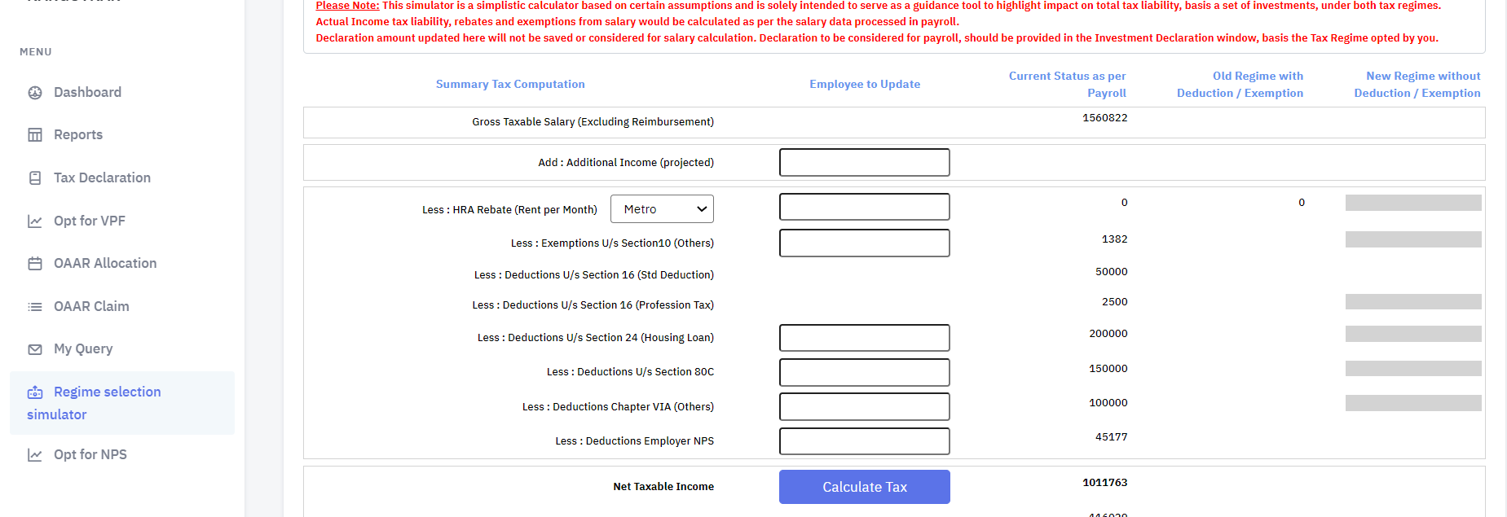
Income tax simulator (screenshot from HGs portal)
Regime Selection Simulator : Kindly login into HGS Portal – Menu Tab – Select “Regime Selection Simulator” Current Status as per Payroll : Gross Income captured as per last financial year Employee to update : Employees are required to update their additional income, deductions and exemptions for the current FY Calculate Tax : Click on the Calculate tax button to arrive at the revised income tax payable amount for both the tax regimes Old / New Regime Computation : Once you click on the Calculate tax button, the system computes the revised income tax payable amount for both the regimes. System also recommends which tax regime is beneficial for you.
3
2
5
5
1
4

Slide 11
HGS portal – selection of tax regime
As per the Union Budget changes for Financial Year 2023-24, HGS Team has enabled the New Income Tax Regime as default tax regime for all the Employees Employees who wish to opt for Old Regime, will have to login into HGS Portal and choose the Old Tax Regime. Once you change and opt for Old Tax Regime, the same cannot be changed or modified later on during the financial year. Follow the below steps to change the tax regime from New Regime to Old Regime Login into HGS Portal and go to Dashboard Select Tax Declaration Current status shows New Regime as default Click on the change status button. A new window opens with Old Regime and New Regime. Select the Old Regime and click on the Confirm button Note : In New tax Regime, you can declare only Previous Employer Income (For New Joiners joining during FY 2023-24) and Additional income, If any. Only these two tabs will be enabled for you. However, if you are opting for Old tax regime, then, all the investments tab will be enabled automatically (Investments under Section 80C, Other than 80C, HRA, Home loan, Previous Employer Income, Additional Income)

Slide 12
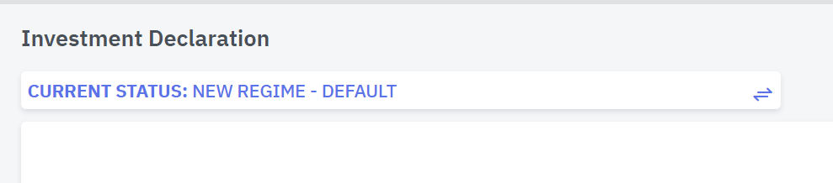
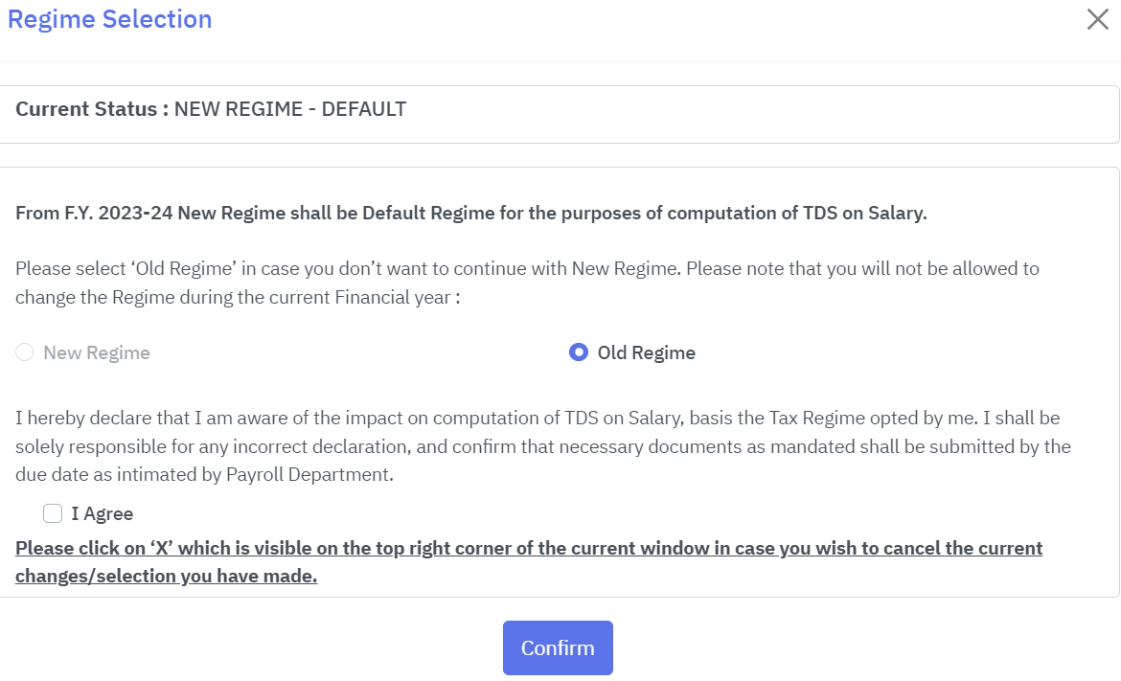
HGS portal – selection of tax regime
Change Status : Click on the arrow button to change the Regime from New to Old. A new window will open up.
Old Regime : Select the Old Regime Radio button to change your tax regime from New regime to Old regime
Confirm : Once you have decided to opt to Old Regime, select the Old Regime and click on Confirm Button. Note that, once you change and opt for Old Tax Regime, the same cannot be changed or modified later on during the financial year.
Cancel Button : If you are unsure about your decision midway, you can click on the cancel button.
1
4
2
3

Slide 13
Marginal tax rate – Exceeding Rs.7 lakhs per annum
The Finance Bill 2023 has offered a marginal relief for followers of the new tax regime, reducing the tax liability for individuals whose taxable income marginally exceeds Rs 7 lakh.
Particulars | Case Study - 1 | Case Study - 2 | Case Study - 3 | Case Study - 4 | Case Study - 5
Effective Tax-Free Salary income (A) | ₹ 7,50,000 | ₹ 7,55,000 | ₹ 7,60,000 | ₹ 7,70,000 | ₹ 7,79,018
Less : Standard Deduction (B) | ₹ 50,000 | ₹ 50,000 | ₹ 50,000 | ₹ 50,000 | ₹ 50,000
Gross Total Income (C = A-B) | ₹ 7,00,000 | ₹ 7,05,000 | ₹ 7,10,000 | ₹ 7,20,000 | ₹ 7,29,018
Less : Chapter VI-A deductions (D) | ₹ 0 | ₹ 0 | ₹ 0 | ₹ 0 | ₹ 0
Taxable Income level for Rebate eligibility (C-D) | ₹ 7,00,000 | ₹ 7,05,000 | ₹ 7,10,000 | ₹ 7,20,000 | ₹ 7,29,018
Income Tax on above Income (as per slab rates) (E) | ₹ 25,000 | ₹ 25,500 | ₹ 26,000 | ₹ 27,000 | ₹ 27,902
Less: Rebate under Section 87A | ₹ -25,000 | ₹ 0 | ₹ 0 | ₹ 0 | ₹ 0
Add : Education Cess on Income Tax @ 4% (F) | ₹ 0 | ₹ 1,020 | ₹ 1,040 | ₹ 1,080 | ₹ 1,116
Total Income tax payable (G) | ₹ 0 | ₹ 26,520 | ₹ 27,040 | ₹ 28,080 | ₹ 29,018
Marginal Increase in Income exceeding Rs.7 lakhs (H) |  | ₹ 5,000 | ₹ 10,000 | ₹ 20,000 | ₹ 29,018
Marginal Relief (G) – (H) |  | ₹ 21,520 | ₹ 17,040 | ₹ 8,080 | ₹ 0
Net tax payable |  | ₹ 5,000 | ₹ 10,000 | ₹ 20,000 | ₹ 29,018

